Slide 1
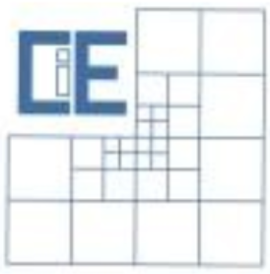
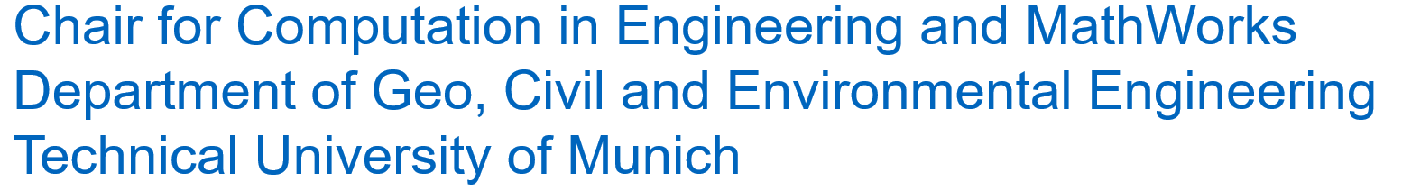
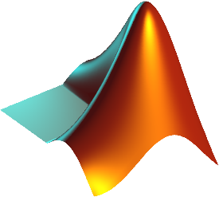
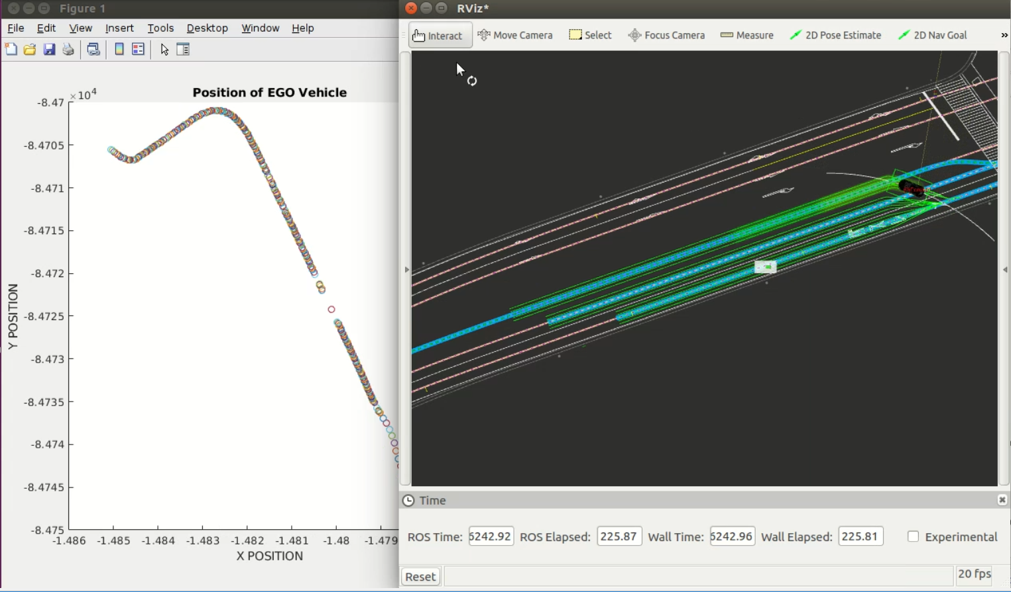
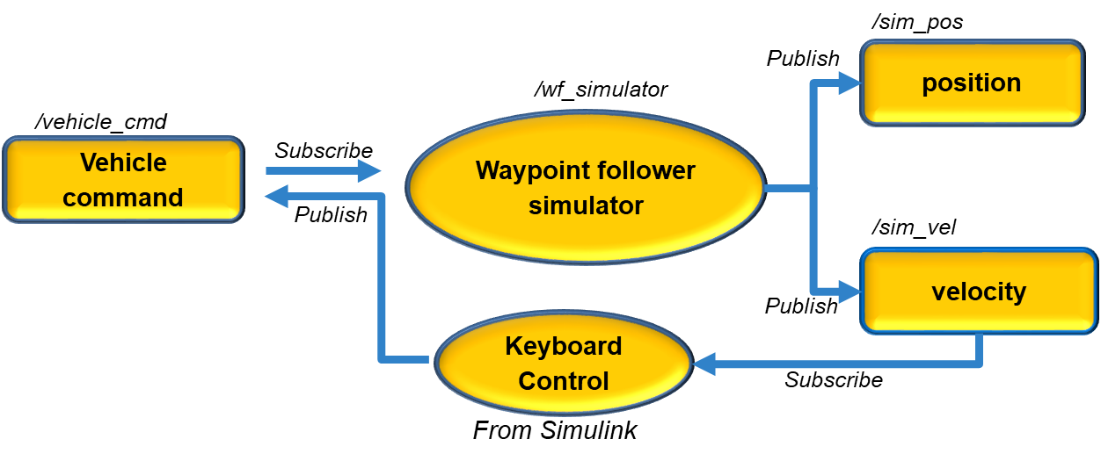
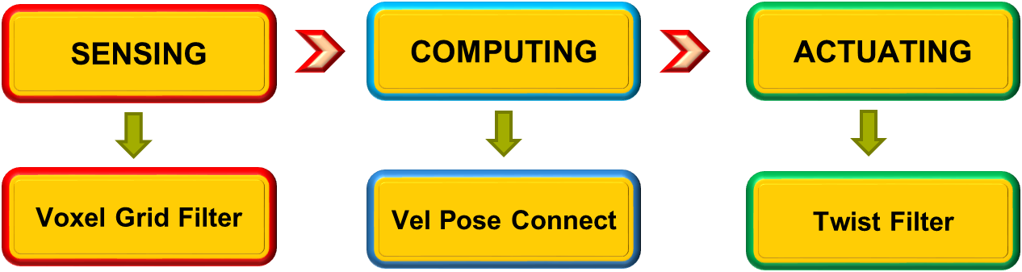
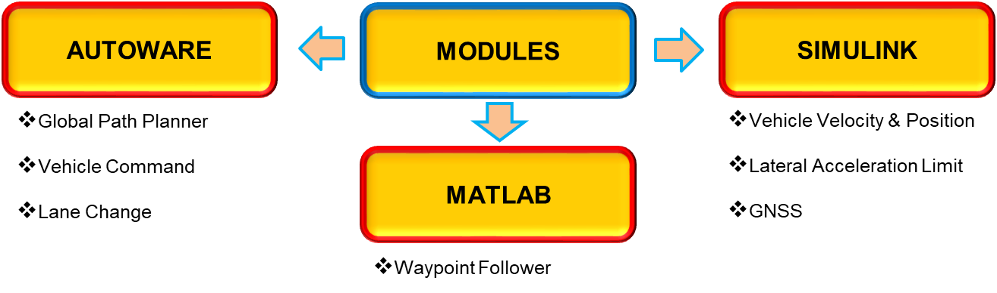
Automated Driving Systems – Co-Simulating Autoware with Simulink Software Lab Project 2019
Alperen Kıral, Daniyal Ahmed, Phuris Khunphakdee
Supervisors: Dr. Christoph Hahn, Steve Schäfer
Abstract
This project presents methods to demonstrate interconnectivity between Autoware and MATLAB using Robotics Operating System (ROS). This also aims to provide an example of automated driving co-simulation.
Motivation
Autoware, an open-source platform, is a ROS-based automated driving stack. It is widely used in the research and development for autonomous driving. Co-Simulation between Autoware and MATLAB/Simulink will allow the users to develop autonomous vehicle functions directly from their preferred environment; hence, the amount of time and effort that would be required for ROS programming is reduced. The final goal of the project is to form a closed loop system for autonomous driving vehicles by performing modules from each of the basic functionalities of self-driving cars: sensing, computing, and actuating.
Achievements
The achievements can be summarized as:
A Closed loop system: Forming a closed loop system consisting of sensing, computing and actuating functionalities.
Automated Script: Setting up simulation model in Autoware is a time-consuming process, so in order to speed up the procedure, an automated script has been created which populates the field of Autoware GUI almost three times faster.
Lane Change with Obstacle: A Simulink model was implemented which consists of the three modules running together with Autoware so that ego vehicle can avoid suddenly appearing obstacles by changing lanes.
Manually controlling the vehicle: A manual mode was implemented to control the ego vehicle via a keyboard in case of control algorithms failure.
Conclusion
This project provides a path to an individual who is interested in pursuing the field of autonomous driving. The solutions to the problems faced during installation phase have been well-documented which is believed to provide adequate assistance to the users.
The automated script which can further be extended would provide a friendly experience to the users who can easily populate the required field in Autoware GUI, leading to a much faster process of simulation in Autoware. Additionally, a user has a possibility to try other examples of his/her choice belonging to each of the functionalities of Autoware, by following the same procedures outlined in the documentation.
References
[1] Maruyama, Y., (2018). Autoware on board: Enabling autonomous vehicles with embedded systems.
[2] Tokunaga, S., (2019). IDF – Autoware: Integrated development framework for ROS-Based self-driving systems using MATLAB/Simulink
[3] Software Lab – Co-Simulation of Autoware with MATLAB & Simulink, Git Repository available at: https://gitlab.lrz.de/ge73xoh/software-lab---autoware.git

